Slide 1


Note: The data and information in this document is reflective of a hypothetical situation and client. This document is to be used for KPMG Virtual Internship purposes only.
Sprocket Central Pty Ltd
Data analytics approach
Data analytics – Sandra Moses [Junior Consultant]

Slide 2
Note: The data and information in this document is reflective of a hypothetical situation and client. This document is to be used for KPMG Virtual Internship purposes only.
Agenda
Introduction
Data Exploration
Model Development
Interpretation

Slide 3




Note: The data and information in this document is reflective of a hypothetical situation and client. This document is to be used for KPMG Virtual Internship purposes only.
Introduction
Analyze customer data and find trends
Week 1
DATA EXPLORATION
Week 2
MODEL BUILDING
Week 3
INTERPRETATION
Clean Data
Identify Trends
Recommend Customers

Slide 4
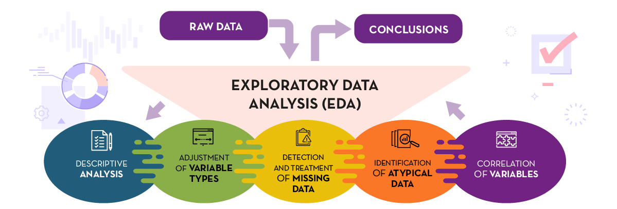
Note: The data and information in this document is reflective of a hypothetical situation and client. This document is to be used for KPMG Virtual Internship purposes only.
Data Exploration
Exploratory Data Analysis to Find Insights
The Dataset:
Customer demographic
Customer address
Transactions

Slide 5
Note: The data and information in this document is reflective of a hypothetical situation and client. This document is to be used for KPMG Virtual Internship purposes only.
Data Exploration - Continued
Exploratory Data Analysis to Find Insights
Data Distrubution
Histograms plots
Feature Engineering
Feature Selection
Select the best features for the model
Statistical Analysis
Adding new columns from date (Months, Weeks, Seasons, Weekends, etc.)
Feature transformation (Grouping age, tenure, etc.)
Detecting Outliers
Descriptive Analysis
Adjustment of variables types
Correlation Matrix

Slide 6

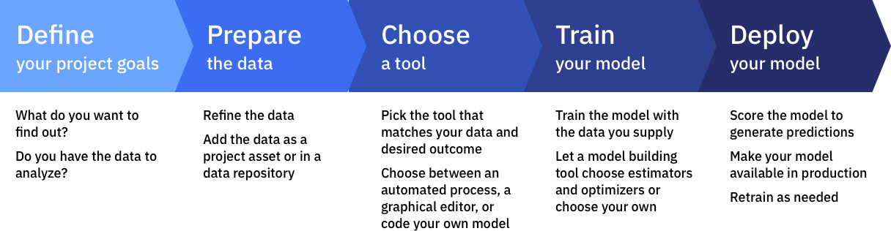
Note: The data and information in this document is reflective of a hypothetical situation and client. This document is to be used for KPMG Virtual Internship purposes only.
Model Development
Model development is an iterative process, in which many models are derived, tested and built upon until a model fitting the desired criteria is built.

Slide 7



Note: The data and information in this document is reflective of a hypothetical situation and client. This document is to be used for KPMG Virtual Internship purposes only.
Interpretation
Interpretating results and reporting
Finally, in the last week we will be able to reap what we sow and reach the share & act phase.
We will prepare a dashboard that will help visualize important trends, data distributions, business insights and results of our hypothesis in an easily graspable manner.
The dashboard will have filters to choose between brands, job types, months and states to recommend which of the 1000 new customers should be targeted to drive the most value for the organization.

Slide 8
Note: The data and information in this document is reflective of a hypothetical situation and client. This document is to be used for KPMG Virtual Internship purposes only.
Thank you

